Slide 1
Collaborative Platform Version 5.0
Team Members
Product Owner
Adrian Alfonso
Juan Caraballo
Jorge Travieso

Slide 4
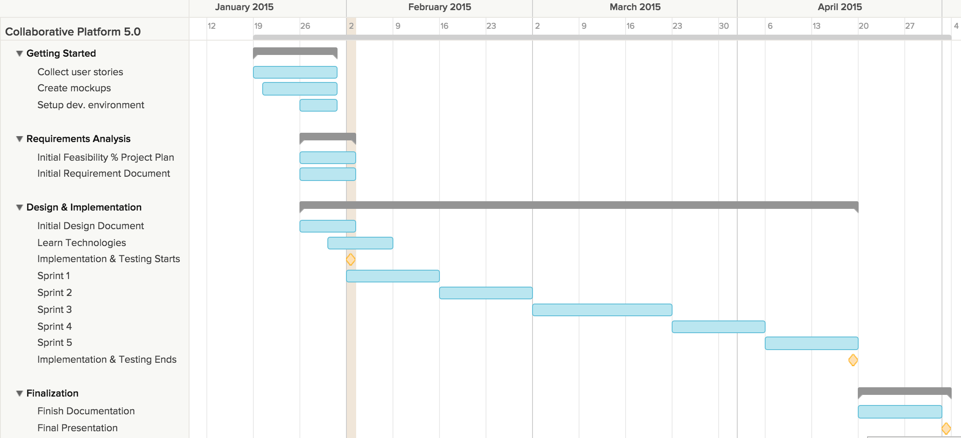
Project plan

Slide 5
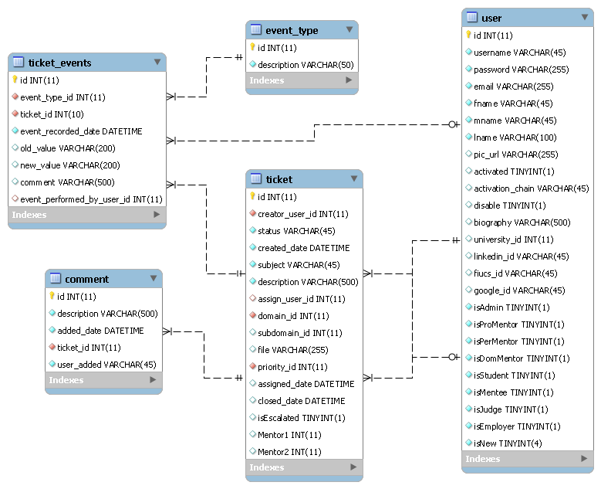
ER Diagram

